Slide 1
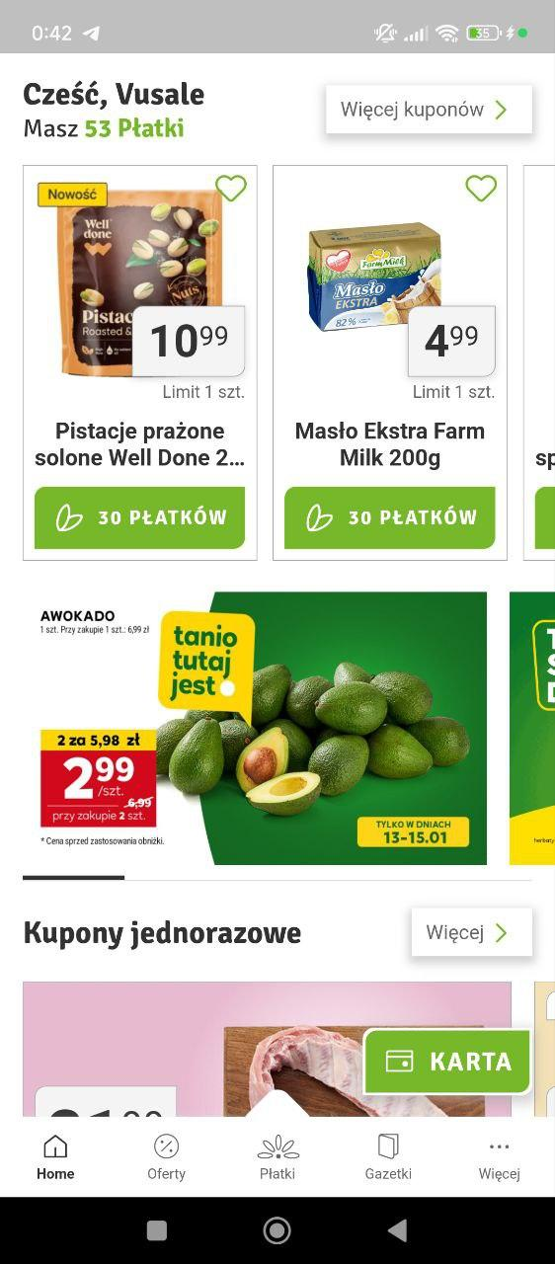
STOKROTKA APP
ANALYSIS

Slide 2
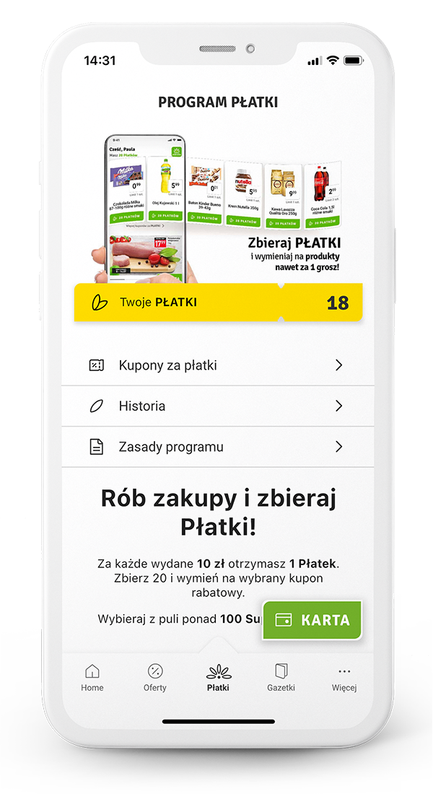
Today’s Agenda
About Stokrotka
Project purpose
Project challenges and their importance
Needed data
Data utilization process
Modified app functionalities
Conclusion

Slide 3
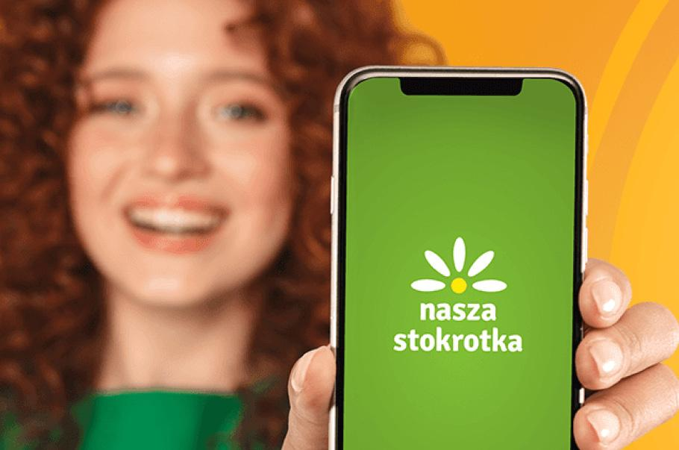
STOKROTKA
Stokrotka Sp. z o.o. is a leading Polish retail chain with supermarkets and mini-markets nationwide. Established in 1994, it focuses on convenience, quality, and affordability.

Slide 4
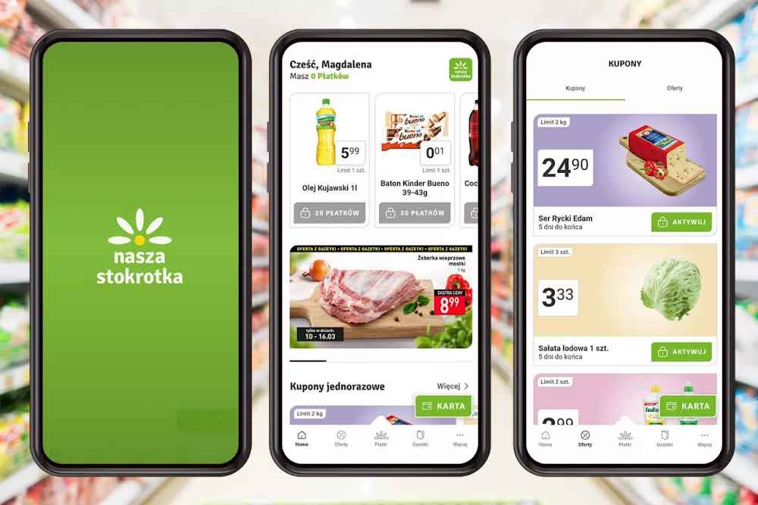
Project Purpose
Increasing the Stokrotka App efficiency.
The primary goal of this project is to analyze user feedback to identify areas for improving the efficiency and usability of the Stokrotka app. By understanding user behaviors, preferences, and pain points, the project aims to provide actionable insights to enhance the app's performance, user experience, and overall satisfaction. This analysis will guide informed decisions for future app updates and feature improvements.

Slide 5
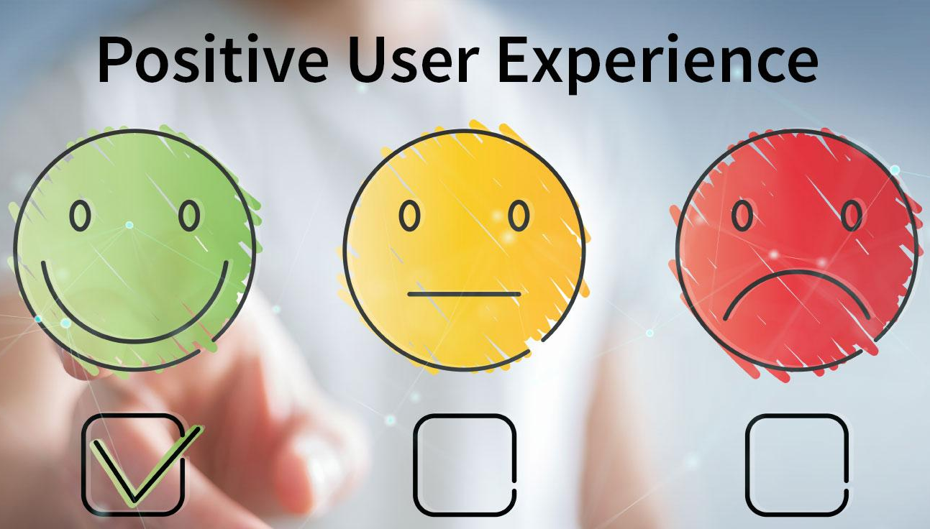
Project Challenges and Their Importance
Current app does not support any other language than Polish.
Current app does not work offline therefore it is impossible to use the collected coupons.
Current app does not have option to filter the products based on the availability in the location or in the stock.
During online shopping, the collected coupons are not accessible.
70%
50%
The lack of essential features in the Stokrotka app can directly impact user engagement, leading to reduced sales and declining revenue. This challenge shows a significant risk to the business's growth and sustainability, as unmet user needs may drive customers toward competitors. Addressing these challenges is critical to maintaining customer loyalty and ensuring business success.
10%
40%
20%

Slide 6
Needed Data
The analyzed data is a combination of user-generated inputs and randomized responses. Data was collected through Google surveys, app review forms, and user reviews from the Google Play Store and Apple Store. Python was used to randomize additional responses for analysis purposes.
Google Form
1
Google Play Store
2
Apple Store
3
Python
4

Slide 7
Data Utilization
After gathering survey responses and randomizing additional entries, I saved the raw data in Excel and performed data cleaning, including removing duplicates, correcting errors, and filtering the dataset. One key challenge was handling multiple values in a single cell, which I resolved using Excel's Power Query tool with the "Split by Delimiter" option for cleaner data. The prepared dataset was then used to create pivot tables and a final dashboard featuring insightful charts and slicers for easy analysis.
Excel
01
02
Power Query
Pivot Table/
Final Dashboard
03

Slide 8
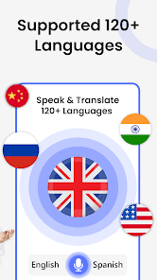
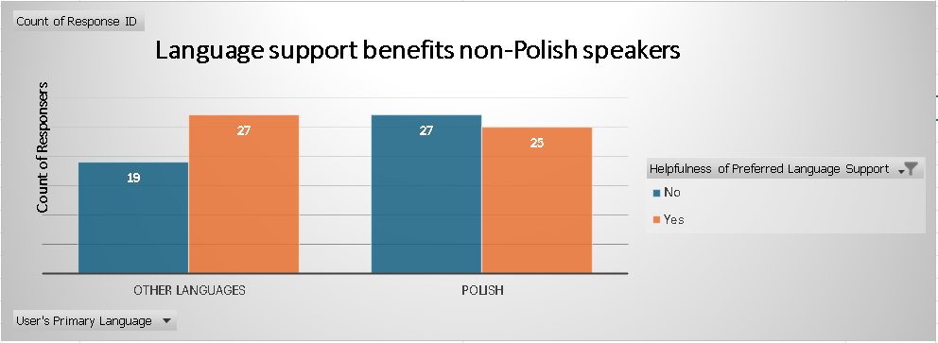
Modified App Functionalities
27 non-Polish and 23 Polish speakers think that “Additional Language Support would be helpful.

Slide 9
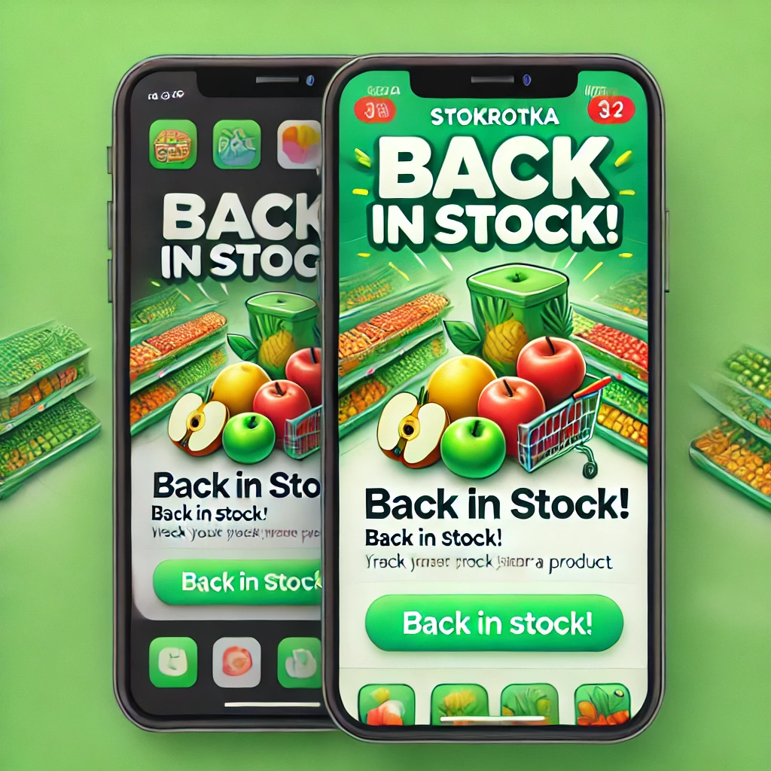
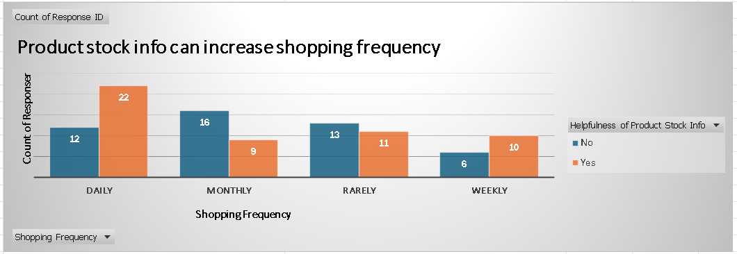
Stock alert
A higher number of daily shoppers (22) and monthly shoppers (9) find product stock info helpful compared to those who don't. This suggests that providing product stock details could significantly impact and encourage frequent shopping behavior.

Slide 10

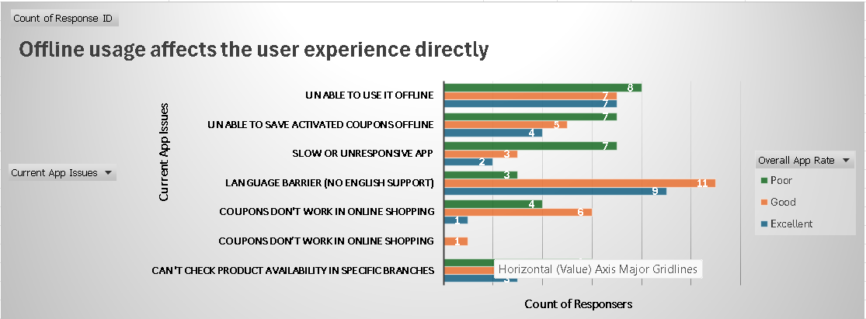
Offline Usage
Common issues such as the inability to use the app offline and save activated coupons offline are strongly associated with lower app ratings (e.g., poor ratings). Language barriers and slow or unresponsive app performance also significantly impact user satisfaction, emphasizing the need for improvements in these areas.

Slide 11
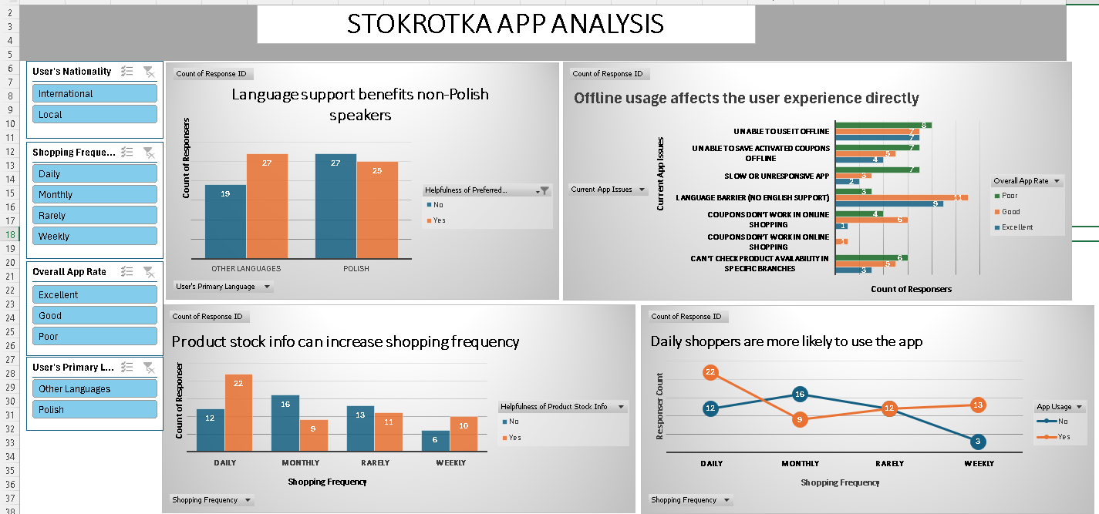
Conclusion

Slide 12
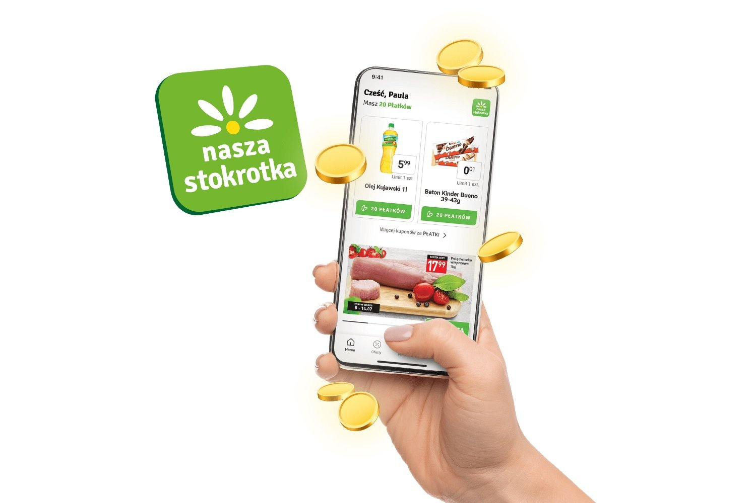
THANK YOU

